Slide 1
CE1107/CZ1107: DATA STRUCTURES AND ALGORITHMS
Stacks and Queues Applications

Slide 2
STACK IMPLEMENTATION USING LINKED LISTS
Stack structure
typedef struct _stack{
LinkedList ll;
} Stack;
Basically wrap up a linked list and use it for the actual data storage
Just need to ensure we control where elements are added/removed
Notice that the LinkedList already takes care of little things like keeping track of number of nodes, etc.
Notice this is a LinkedList, not a LinkedList *
Stack s
LinkedList ll
ListNode *head
int size

Slide 3
QUEUE IMPLEMENTATION USING LINKED LISTS
Queue structure
typedef struct _queue{
LinkedList ll;
} Queue;
Again, wrap up a linked list and use it for the actual data storage
Notice that the LinkedList already takes care of little things like keeping track of # of nodes, etc.
Notice this is a LinkedList, not a LinkedList *
LinkedList ll
Queue q
ListNode *head
int size

Slide 4
LINKED LIST, STACK AND QUEUE FUNCTIONS
int insertNode(LinkedList *ll, int index, int value);
int removeNode(LinkedList *ll, int index);
ListNode * findNode(LinkedList *ll, int index);
void printList(LinkedList *ll);
void push(Stack *s, int item);
int pop(Stack *s);
int peek(Stack *s);
int isEmptyStack(Stack *s);
void enqueue(Queue *q, int item);
int dequeue(Queue *q);
int peek(Queue *q);
int isEmptyQueue(Queue *s);
LinkedList *ll
ListNode *head
0×100
10
20
2
int size
Stack s
LinkedList ll
ListNode *head
10
int size
Queue q
LinkedList ll
ListNode *head
10
int size

Slide 5
STACK AND QUEUE APPLICATIONS
Queue
Palindromes (In lab)
Scheduling in multitasking, network job, mailbox etc.
Sequence of commands for a unit in a game
Any applications that behave a like queue
Stack
Reversing a list
Parentheses checker (Balanced Parentheses Problem (In lab))
Algebraic expression conversion (infix, prefix and postfix)
Recursive functions to Iterative functions (Binary Tree)

Slide 6
Question 3
Write a function palindrome() that determines whether a given string is a palindrome. The prototype for the palindrome() function is given below:
int palindrome(char *word);
The function should return 0 if the string is a palindrome and -1 otherwise. You should ignore the null terminator. Ignore the case of each letter.
Sample output:
Enter a string: A man a plan a canal Panama
The string is a palindrome.
Enter a string: Superman in the sky
The string is not a palindrome.

Slide 7

Question 1 - Template.c
Question 3 - Template.c
1
2
3
4
5
6
7
8
9
10
11
12
13
14
15
16
17
18
19
20
21
22
23
24
25
26
27
28
29
30
31
32
33
34
35
36
37
int main(){
char* expression=NULL;
int i;
char item;
Queue q;
q.ll.head=NULL;
q.ll.tail=NULL;
q.ll.size=0;
printf("Enter a string of characters, terminated by a newline:\n");
while(1){
scanf("%c",&item);
if(item=='\n') break;
enqueue(&q,item);
}
enqueue(&q,'\0');
expression = malloc(sizeof(char)*q.ll.size);
i=0;
while(!isEmptyQueue(&q)){
expression[i++] = peekQueue(&q);
dequeue(&q);
}
int result=palindrome(expression);
if (result==0){
printf("The string is a palindrome.\n");
}else{
printf("The string is not a palindrome.\n");
}
if(!expression){
free(expression);
expression=NULL;
}
return 0;
}
typedef struct _linkedlist{
ListNode *head;
int size;
ListNode *tail;
} LinkedList;

Slide 8
Question 3 – palindrome()
1
2
3
4
5
6
7
8
9
10
11
12
13
14
15
16
17
18
19
20
21
22
23
24
25
26
27
28
29
30
31
32
33
void palindrome1(char *word){
int i;
Stack s; Queue q;
s.ll.head = NULL;
s.ll.tail = NULL;
s.ll.size = 0;
q.ll.head = NULL;
q.ll.tail = NULL;
q.ll.size = 0;
// Put the whole string in a stack and a queue, stripping out spaces
printf("%s\n", word);
while (*word){
if (*word != ' '){
push(&s, toupper(*word));
enqueue(&q, toupper(*word));
}
word++;
}
// divide size by 2,ignore the middle character in an odd-length string
i = s.ll.size / 2; //i = 2 (5/2=2)
// Pop first half of stripped string off the stack
//Compare with the second half
while (i > 0){
if (pop(&s) != dequeue(&q)){
printf("The string is not a palindrome\n");
return;
}
i--;
}
printf("The string is a palindrome\n");
}
Using stack and queue
typedef struct _linkedlist{
ListNode *head;
int size;
ListNode *tail;
} LinkedList;

Slide 9
Question 3 – palindrome()
1
2
3
4
5
6
7
8
9
10
11
12
13
14
15
16
17
18
19
20
21
22
23
24
25
26
27
28
29
30
31
32
33
void palindrome1(char *word){
int i;
Stack s; Queue q;
s.ll.head = NULL;
s.ll.tail = NULL;
s.ll.size = 0;
q.ll.head = NULL;
q.ll.tail = NULL;
q.ll.size = 0;
// Put the whole string in a stack and a queue, stripping out spaces
printf("%s\n", word);
while (*word){
if (*word != ' '){
push(&s, toupper(*word));
enqueue(&q, toupper(*word));
}
word++;
}
// divide size by 2,ignore the middle character in an odd-length string
i = s.ll.size / 2; //i = 2 (5/2=2)
// Pop first half of stripped string off the stack
//Compare with the second half
while (i > 0){
if (pop(&s) != dequeue(&q)){
printf("The string is not a palindrome\n");
return;
}
i--;
}
printf("The string is a palindrome\n");
}
Using stack and queue
typedef struct _linkedlist{
ListNode *head;
int size;
ListNode *tail;
} LinkedList;

Slide 10
PARENTHESES
Operators | Precedence
*, /, % | Highest
+, -
<<, >>
&&
= | Lowest
Parentheses -- (, ) Used mathematic expression in enforce precedence of operation
Example: A + (B + C)*D Well-nested or valid, e.g. (a+b)*(a-b), Not valid: . (a+(b)*(a-b)
Similarly [, ] , {,} used in programing language
In parsing the source, need to check if parentheses are well-nested.
Further generation for mark-up language, like HTML, tags needs to be well-nested.
How to check if parentheses are valid

Slide 11
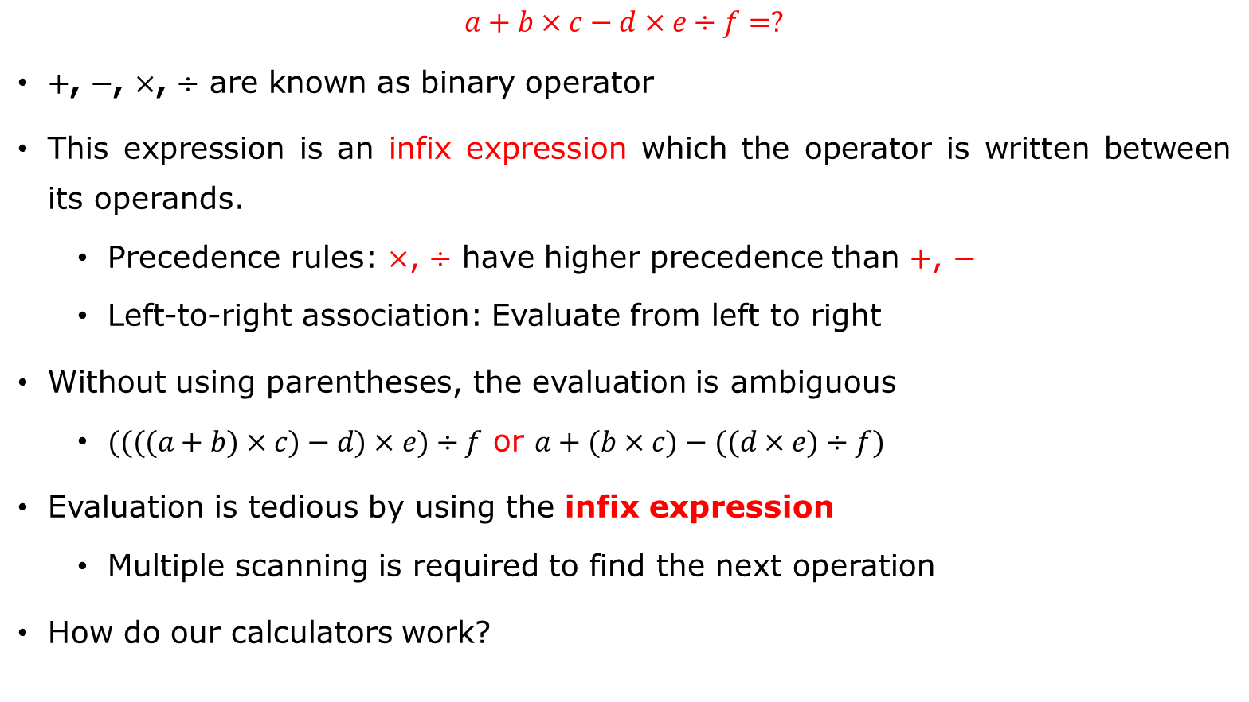
Algebraic expression
$$a+b×c−d×e÷f=?$$
$+$, $−$, $×$, $÷$ are known as binary operator
This expression is an infix expression which the operator is written between its operands.
Precedence rules: $×$, $÷$ have higher precedence than $+$, $−$
Left-to-right association: Evaluate from left to right
Without using parentheses, the evaluation is ambiguous
$((((a+b)×c)−d)×e)÷f$ or $a+(b×c)−((d×e)÷f)$
Evaluation is tedious by using the infix expression
Multiple scanning is required to find the next operation
How do our calculators work?
The expression is stored as a string
“a+b*c”
How does computer interpret the string?

Slide 12
Infix
Operators | Precedence
*, /, % | Highest
+, -
<<, >>
&&
= | Lowest
While writing an arithmetic expression using Infix notation, the operator is placed between the operands.
For example, A+B; here, plus operator is placed between the two operands A and B.
A * ( B + C ) / D means: "First add B and C together, then multiply the result by A, then divide by D to give the final answer."
Information is needed about operator precedence, associativity rules, and brackets which overrides these rules.
Although it is easy to write expressions using infix notation, computers find it difficult to parse as they need a lot of information to evaluate the expression.

Slide 13
Postfix Notation
Postfix notation which is better known as Reverse Polish Notation or RPN.
In Postfix notation, the operator is placed after the operands. For example, if an expression is written as A+B in Infix notation, the same expression can be written as AB+ in Postfix notation.
Operators are written after their operands
The order of evaluation of a postfix expression is always from left to right.

Slide 14
Postfix Notation
The expression (A + B) * C is written as: AB+C* in the postfix notation.
A postfix operation does not even follow the rules of operator precedence. The operator which occurs first in the expression is operated first on the operands.
No parentheses
For example, given a postfix notation AB+C*. While evaluation, addition will be performed prior to multiplication.

Slide 15
Prefix Notation
In a Prefix notation, the operator is placed before the operands.
For example, if A+B is an expression in Infix notation, then the corresponding expression in prefix notation is given by +AB.
While evaluating a prefix expression, the operators are applied to the operands that are present immediately on the right of the operator.
Prefix expressions also do not follow the rules of operator precedence and associativity.
The expression (A + B) * C is written as: *+ABC in the prefix notation
So, computers work more efficiently with expressions written using Prefix and Postfix notations.

Slide 16
Convert the infix expression into its equivalent postfix expression
Step 1: Add ‘)” to the end of the infix expression
Step 2: Push “(“ on to the stack
Step 3: Repeat until each character in the infix notation is scanned
IF a “(“ is encountered, push it on the stack
IF an operand (whether a digit or an alphabet) is encountered,
add it to the postfix expression.
IF a “)” is encountered, then;
. Repeatedly pop from stack and add it to the postfix expression until a “(” is encountered.
b. Discard the “(“. That is, remove the “(“ from stack and do not
add it to the postfix expression
IF an operator X is encountered, then;
Repeatedly pop from stack and add each operator (popped from the stack) to the postfix expression which has the same precedence or a higher precedence than X
b. Push the operator X to the stack
Step 4: Repeatedly pop from the stack and add it to the postfix expression
until the stack is empty
Step 5: EXIT

Slide 17
Convert the infix expression into its equivalent postfix expression
Example: Evaluate “7 - (( 3 * 4) + 8) / 5”.
infix | Stack | postfix
( | (
7 | ( | 7
- | ( - | 7
( | (-( | 7
( | (-(( | 7
3 | (-(( | 7 3
* | (-((* | 7 3
4 | (-((* | 7 3 4
) | (-( | 7 3 4 *
+ | (-(+ | 7 3 4 *
8 | (-(+ | 7 3 4 * 8
) | (- | 7 3 4 * 8 +
/ | (-/ | 7 3 4 * 8 +
5 | (-/ | 7 3 4 * 8 + 5
) |  | 7 3 4 * 8 + 5 / -
Infix “(7 - (( 3 * 4) + 8) / 5)" Postfix “7 3 4 * 8 + 5 /

Slide 18
Evaluate the postfix expression
Step 1: Add a “)” at the end of the postfix expression
Step 2: Scan every character of the postfix expression and repeat
steps 3 and 4 until “)”is encountered
Step 3: IF an operand is encountered, push it on the stack
IF an operator X is encountered, then
a. pop the top two elements from the stack as A and B
b. Evaluate B X A, where A was the topmost element and B was
the element below A.
c. Push the result of evaluation on the stack
[END OF IF]
Step 4: SET RESULT equal to the topmost element of the stack
Step 5: EXIT

Slide 19
Convert the infix expression into its equivalent postfix expression
Example: Evaluate “7 - (( 3 * 4) + 8) / 5”.
Step 1 infix “(7 - (( 3 * 4) + 8) / 5)" => postfix “7 3 4 * 8 + 5 / -“ Step 2 evaluate “7 3 4 * 8 + 5 / -“
infix | Stack | postfix
( | (
7 | ( | 7
- | ( - | 7
( | (-( | 7
( | (-(( | 7
3 | (-(( | 73
* | (-((* | 7 3
4 | (-((* | 7 3 4
) | (-( | 7 3 4 *
+ | (-(+ | 7 3 4 *
8 | (-(+ | 7 3 4 * 8
) | (- | 7 3 4 * 8 +
/ | (-/ | 7 3 4 * 8 +
5 | (-/ | 7 3 4 * 8 + 5
) |  | 7 3 4 * 8 + 5 / -
Character scanned | Stack
7 | 7
3 | 7, 3
4 | 7, 3, 4
* | 7, 12
8 | 7, 12, 8
+ | 7, 20
5 | 7, 20, 5
/ | 7, 4
- | 3

Slide 20



Convert the infix expression into its equivalent postfix expression
infix
$$a+b×c−d×(e÷f)$$
S
$$÷$$
(
x
x
-
+
postfix
a
b
c
d
e
f
$$abc×+def÷×−$$

Slide 21










Evaluation Postfix Expression
$$a+b×c−d×(e÷f)$$
Transform
$$abc×+def÷×−$$
S
f
e
c
d
b
a
$$−$$
$$e÷f$$
x
$$+$$
$$×$$
$$b×c$$
$$÷$$
$$d×(e÷f)$$
$$a+b×c$$

